Slide 1
Monthly Market Wrap
February 2024
Released March 4, 2024

Slide 2
Equity Performance
Charts and tables highlighting the performance of stock market indices, sectors, and individual securities
Notes:
Equities rallied across the board as the NASDAQ led the way with a 6.2% gain. Both the Russell 2000 and Russell 1000 posted gains of around 5.5%, and the S&P 500 advanced 5.3%. The Dow Jones Industrial Average was the relative laggard but still rose 2.5%.
All eleven sectors advanced higher in February. Consumer Discretionary led the way with a 7.9% gain, followed by Industrials at 7.2% and Materials which charged 6.5% higher.

Slide 3
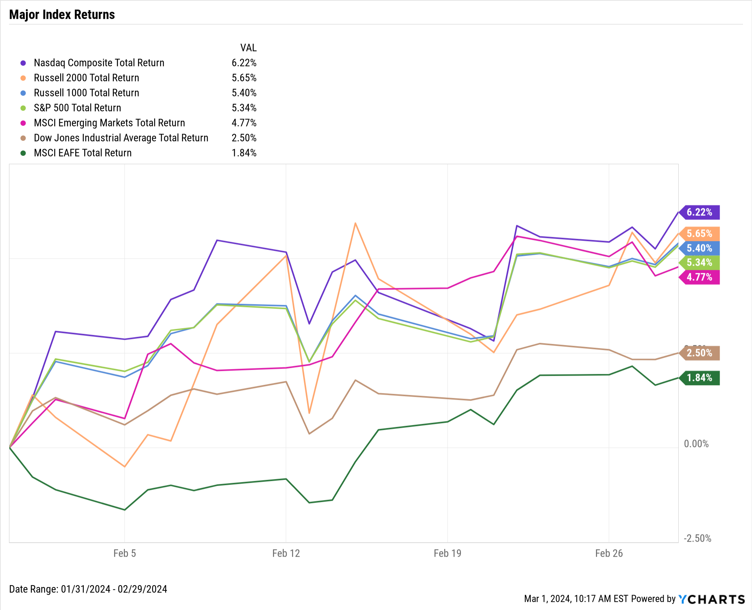
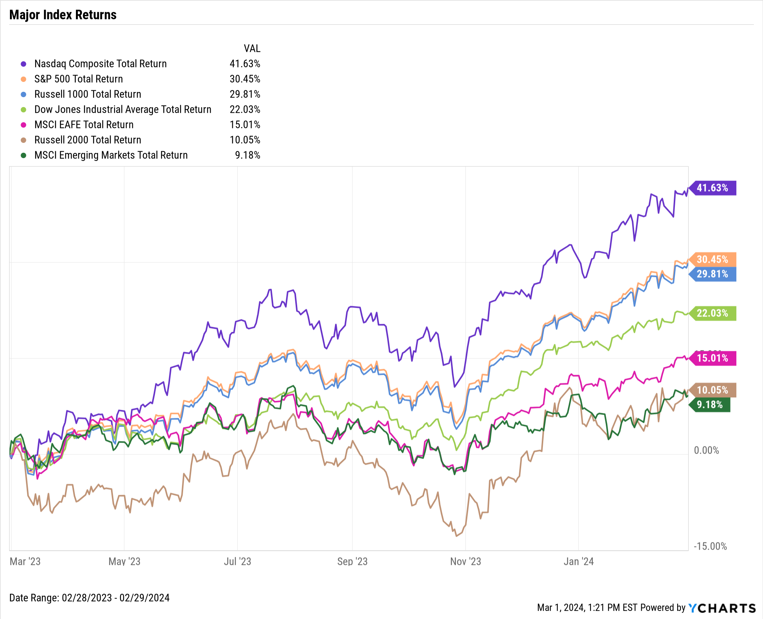
Key Stock Market Index Performance
February 2024:
Equities Rally, Nasdaq up 6.2%; S&P 500 5.3% higher
Trailing Twelve Months (TTM):
Nasdaq up 41.6% over the last twelve months
Notes:
1M Returns:
Nasdaq: 6.2%
Russell 2000: 5.7%
Russell 1000: 5.4%
S&P 500: 5.3%
Emerging Markets: 4.8%
Dow Jones: 2.5%
Developed Markets: 1.6%

Slide 4
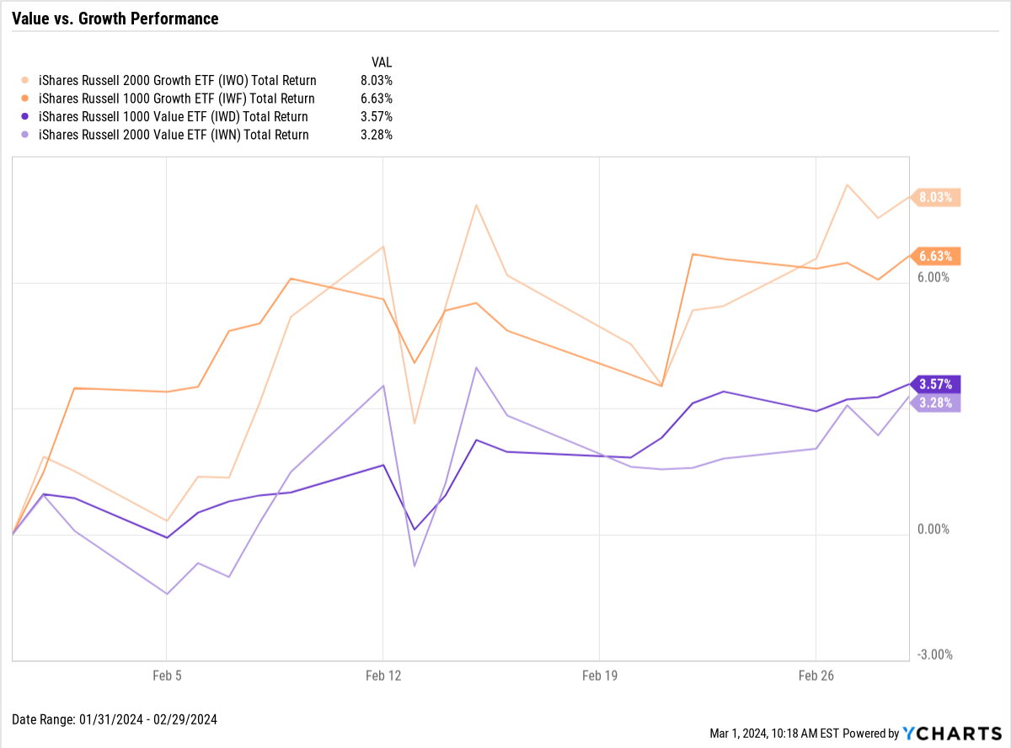
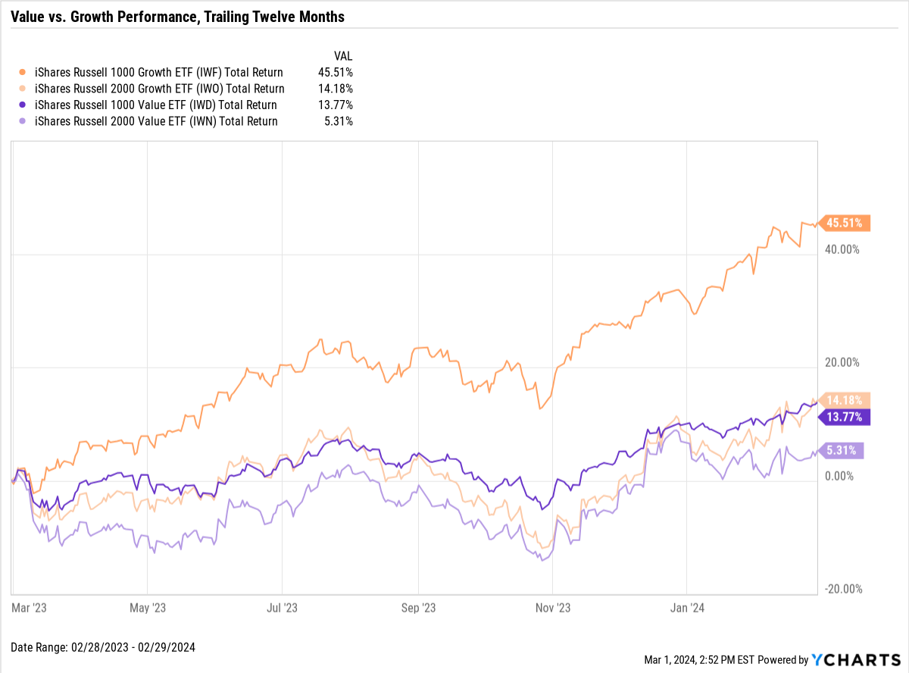
Value vs. Growth Performance
February 2024:
Both Growth and Value rise, Small-cap Growth outpaces
Trailing Twelve Months (TTM):
Large-cap Growth rally fueled by Magnificent Seven stocks; Small-cap Growth and Large-cap Value up similar amounts
Notes:
1-Month:
Small-Cap Growth 1-Month: 8.0%
Large-Cap Growth 1-Month: 6.6%
Large-Cap Value 1-Month: 3.6%
Small-Cap Value 1-Month: 3.3%
TTM:
Large-Cap Growth TTM: 45.5%
Small-Cap Growth TTM: 14.2%
Large-Cap Value TTM: 13.8%
Small-Cap Value TTM: 5.3%

Slide 5
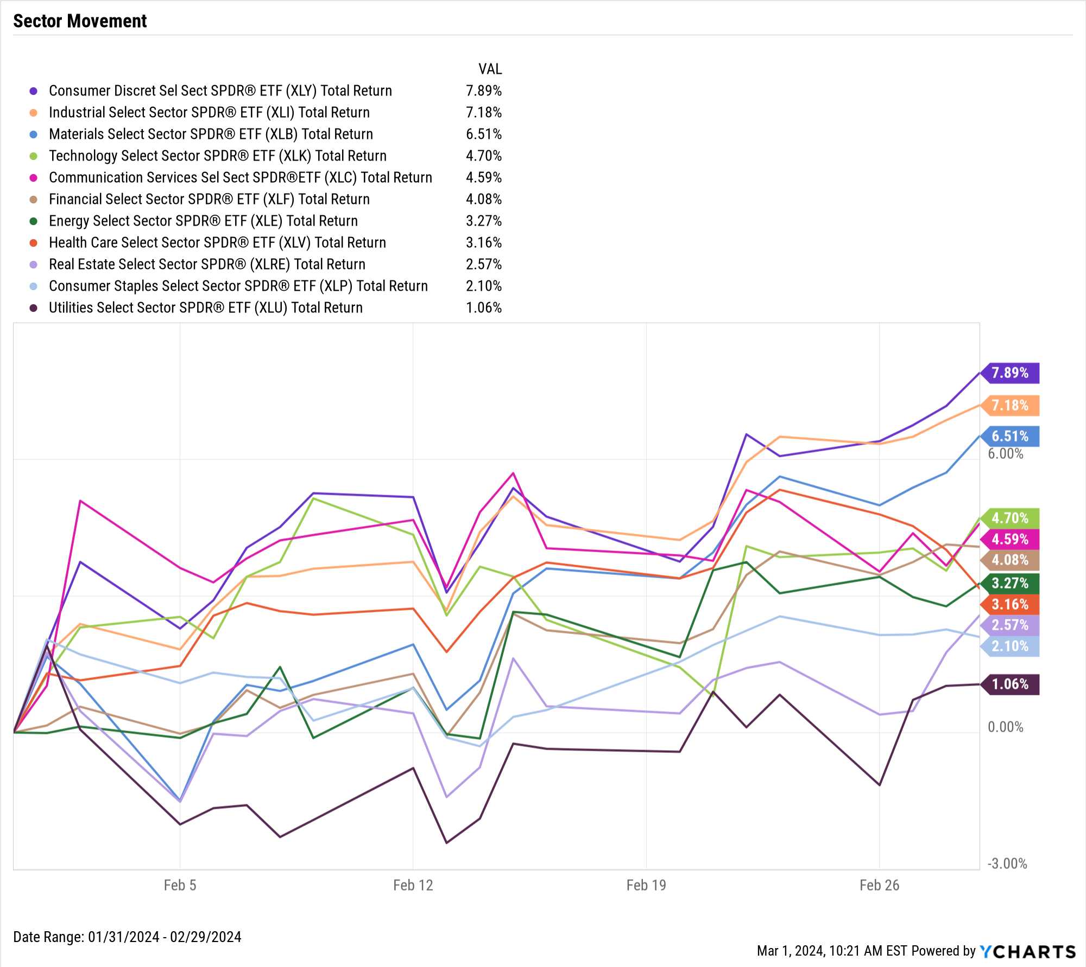
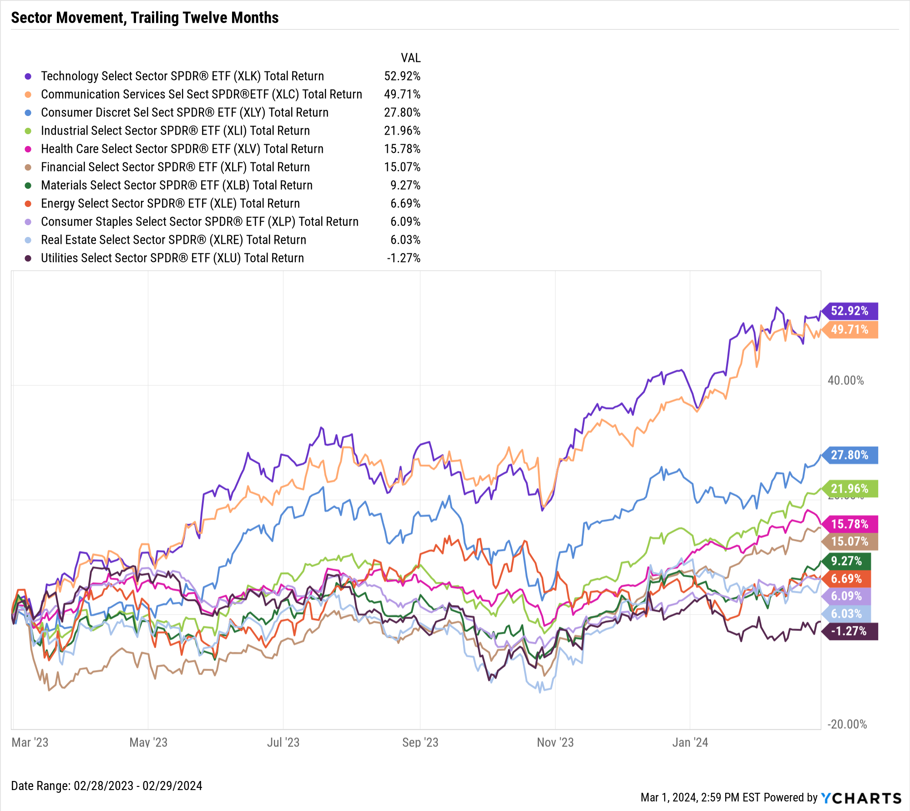
Domestic Sector Performance
February 2024: All sectors positive; Consumer Disc. leads the way
Trailing Twelve Months (TTM): Tech up 52.9%, Comm Services up 49.8%
Notes:
1M Returns:
Consumer Discretionary: 7.9%
Industrials: 7.2%
Materials: 6.5%
Technology: 4.7%
Communication Services: 4.6%
Financials: 4.1%
Energy: 3.3%
Health Care: 3.2%
Real Estate: 2.6%
Consumer Staples: 2.1%
Utilities: 1.1%

Slide 6
Best-Performing S&P 500 Stocks of the Month
Ticker | Name | Feb Price Returns | YTD Price Returns | Industry | Sector
CEG | Constellation Energy Corp | ▲ 38.1% | ▲ 44.1% | Utilities - Renewable | Utilities
RL | Ralph Lauren Corp | ▲ 29.4% | ▲ 28.9% | Apparel Manufacturing | Consumer Cyclical
NVDA | NVIDIA Corp | ▲ 28.6% | ▲ 59.8% | Semiconductors | Technology
META | Meta Platforms Inc | ▲ 25.5% | ▲ 38.3% | Internet Content & Information | Communication Services
PWR | Quanta Services Inc | ▲ 24.5% | ▲ 11.9% | Engineering & Construction | Industrials
GEHC | GE HealthCare Technologies | ▲ 24.4% | ▲ 18.0% | Health Information Services | Healthcare
AXON | Axon Enterprise Inc | ▲ 23.4% | ▲ 19.0% | Aerospace & Defense | Industrials
AMAT | Applied Materials Inc | ▲ 22.7% | ▲ 24.4% | Semiconductor Equipment & Materials | Technology
TPR | Tapestry Inc | ▲ 22.5% | ▲ 29.1% | Luxury Goods | Consumer Cyclical
ENPH | Enphase Energy Inc | ▲ 21.9% | ▼ -3.9% | Solar | Technology
Notes:
1M Returns:
Constellation Energy Corp (CEG): 38.1% gain in February
Ralph Lauren Corp (RL): 29.4%
NVIDIA Corp (NVDA): 28.6%
Meta Platforms Inc (META): 25.5%
Quanta Services Inc (PWR): 24.5%
GE HealthCare Technologies Inc (GEHC): 24.4%
Axon Enterprise Inc (AXON): 23.4%
Applied Materials Inc (AMAT): 22.7%
Tapestry Inc (TPR): 22.5%
Enphase Energy Inc (ENPH): 21.9%

Slide 7
Worst-Performing S&P 500 Stocks of the Month
Ticker | Name | Feb Price Returns | YTD Price Returns | Industry | Sector
PARA | Paramount Global | ▼ -24.3% | ▼ -25.4% | Entertainment | Communication Services
CHTR | Charter Communications Inc | ▼ -20.8% | ▼ -24.4% | Telecom Services | Communication Services
PODD | Insulet Corp | ▼ -14.1% | ▼ -24.4% | Medical Devices | Healthcare
AMGN | Amgen Inc | ▼ -12.9% | ▼ -4.9% | Drug Manufacturers - General | Healthcare
WBD | Warner Bros. Discovery Inc | ▼ -12.3% | ▼ -22.8% | Entertainment | Communication Services
XEL | Xcel Energy Inc | ▼ -12.1% | ▼ -15.0% | Utilities - Regulated Electric | Utilities
BIIB | Biogen Inc | ▼ -12.1% | ▼ -16.2% | Drug Manufacturers - General | Healthcare
CHRW | C.H. Robinson Worldwide Inc | ▼ -11.9% | ▼ -14.2% | Integrated Freight & Logistics | Industrials
TTWO | Take-Two Interactive Software | ▼ -11.0% | ▼ -8.8% | Electronic Gaming & Multimedia | Communication Services
AKAM | Akamai Technologies Inc | ▼ -10.0% | ▼ -6.3% | Software - Infrastructure | Technology
Notes:
1M Returns:
Paramount Global (PARA): -24.3% decline in February
Charter Communications Inc (CHTR): -20.8%
Insulet Corp (PODD): -14.1%
Amgen Inc (AMGN): -12.9%
Warner Bros. Discovery Inc (WBD): -12.3%
Xcel Energy Inc (XEL): -12.1%
Biogen Inc (BIIB): -12.1%
C.H. Robinson Worldwide Inc (CHRW): -11.9%
Take-Two Interactive Software (TTWO): -11.0%
Akamai Technologies Inc (AKAM): -10.0%

Slide 8
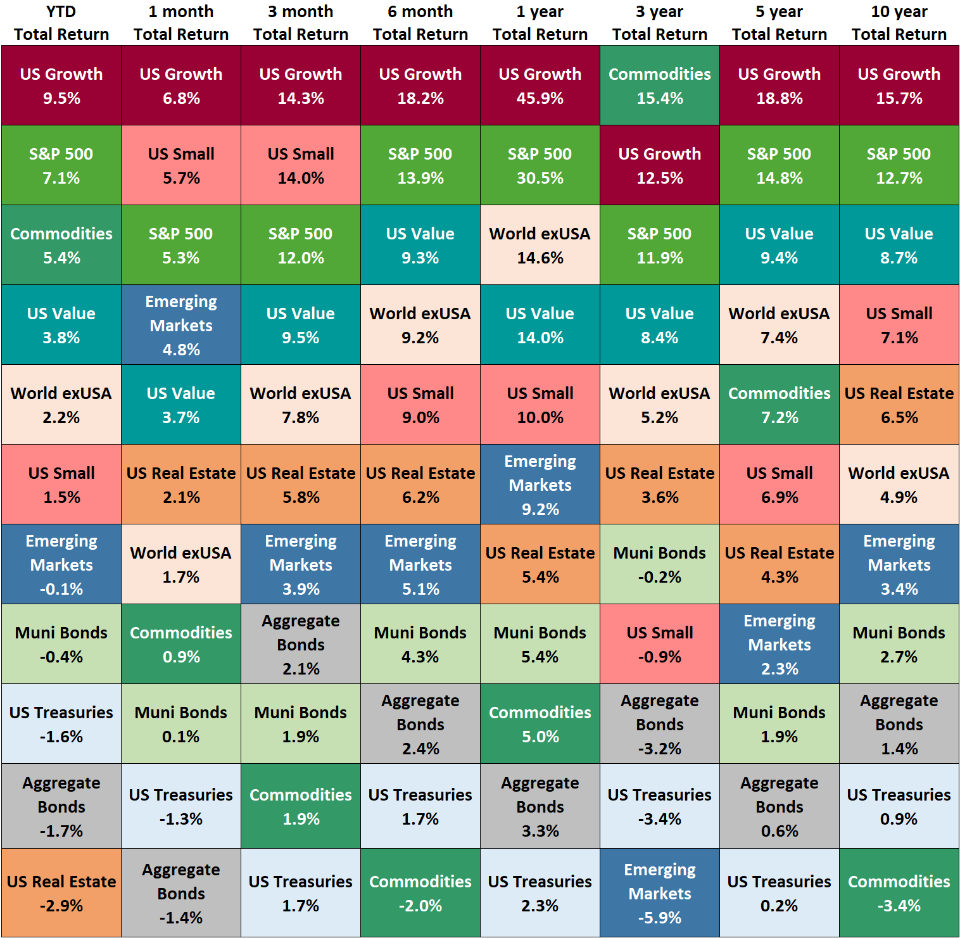
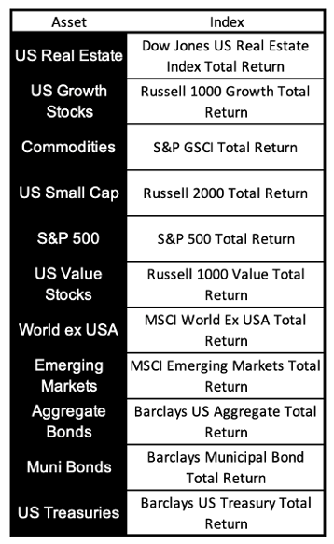
Asset Class Performance

Slide 9
Economic Data
Select charts and data highlighting the major economic events of the past month
Notes:
Core inflation has gradually decelerated over the last 10 months, down to 3.86% in January. Crude oil rose in February, causing the average price of gas to increase 13 cents to $3.37/g. After a flat January, Bitcoin and Ethereum logged respective gains of 45.9% and 44.2% in February, spurred by ETF inflows and ahead of March’s Bitcoin halving event.

Slide 10
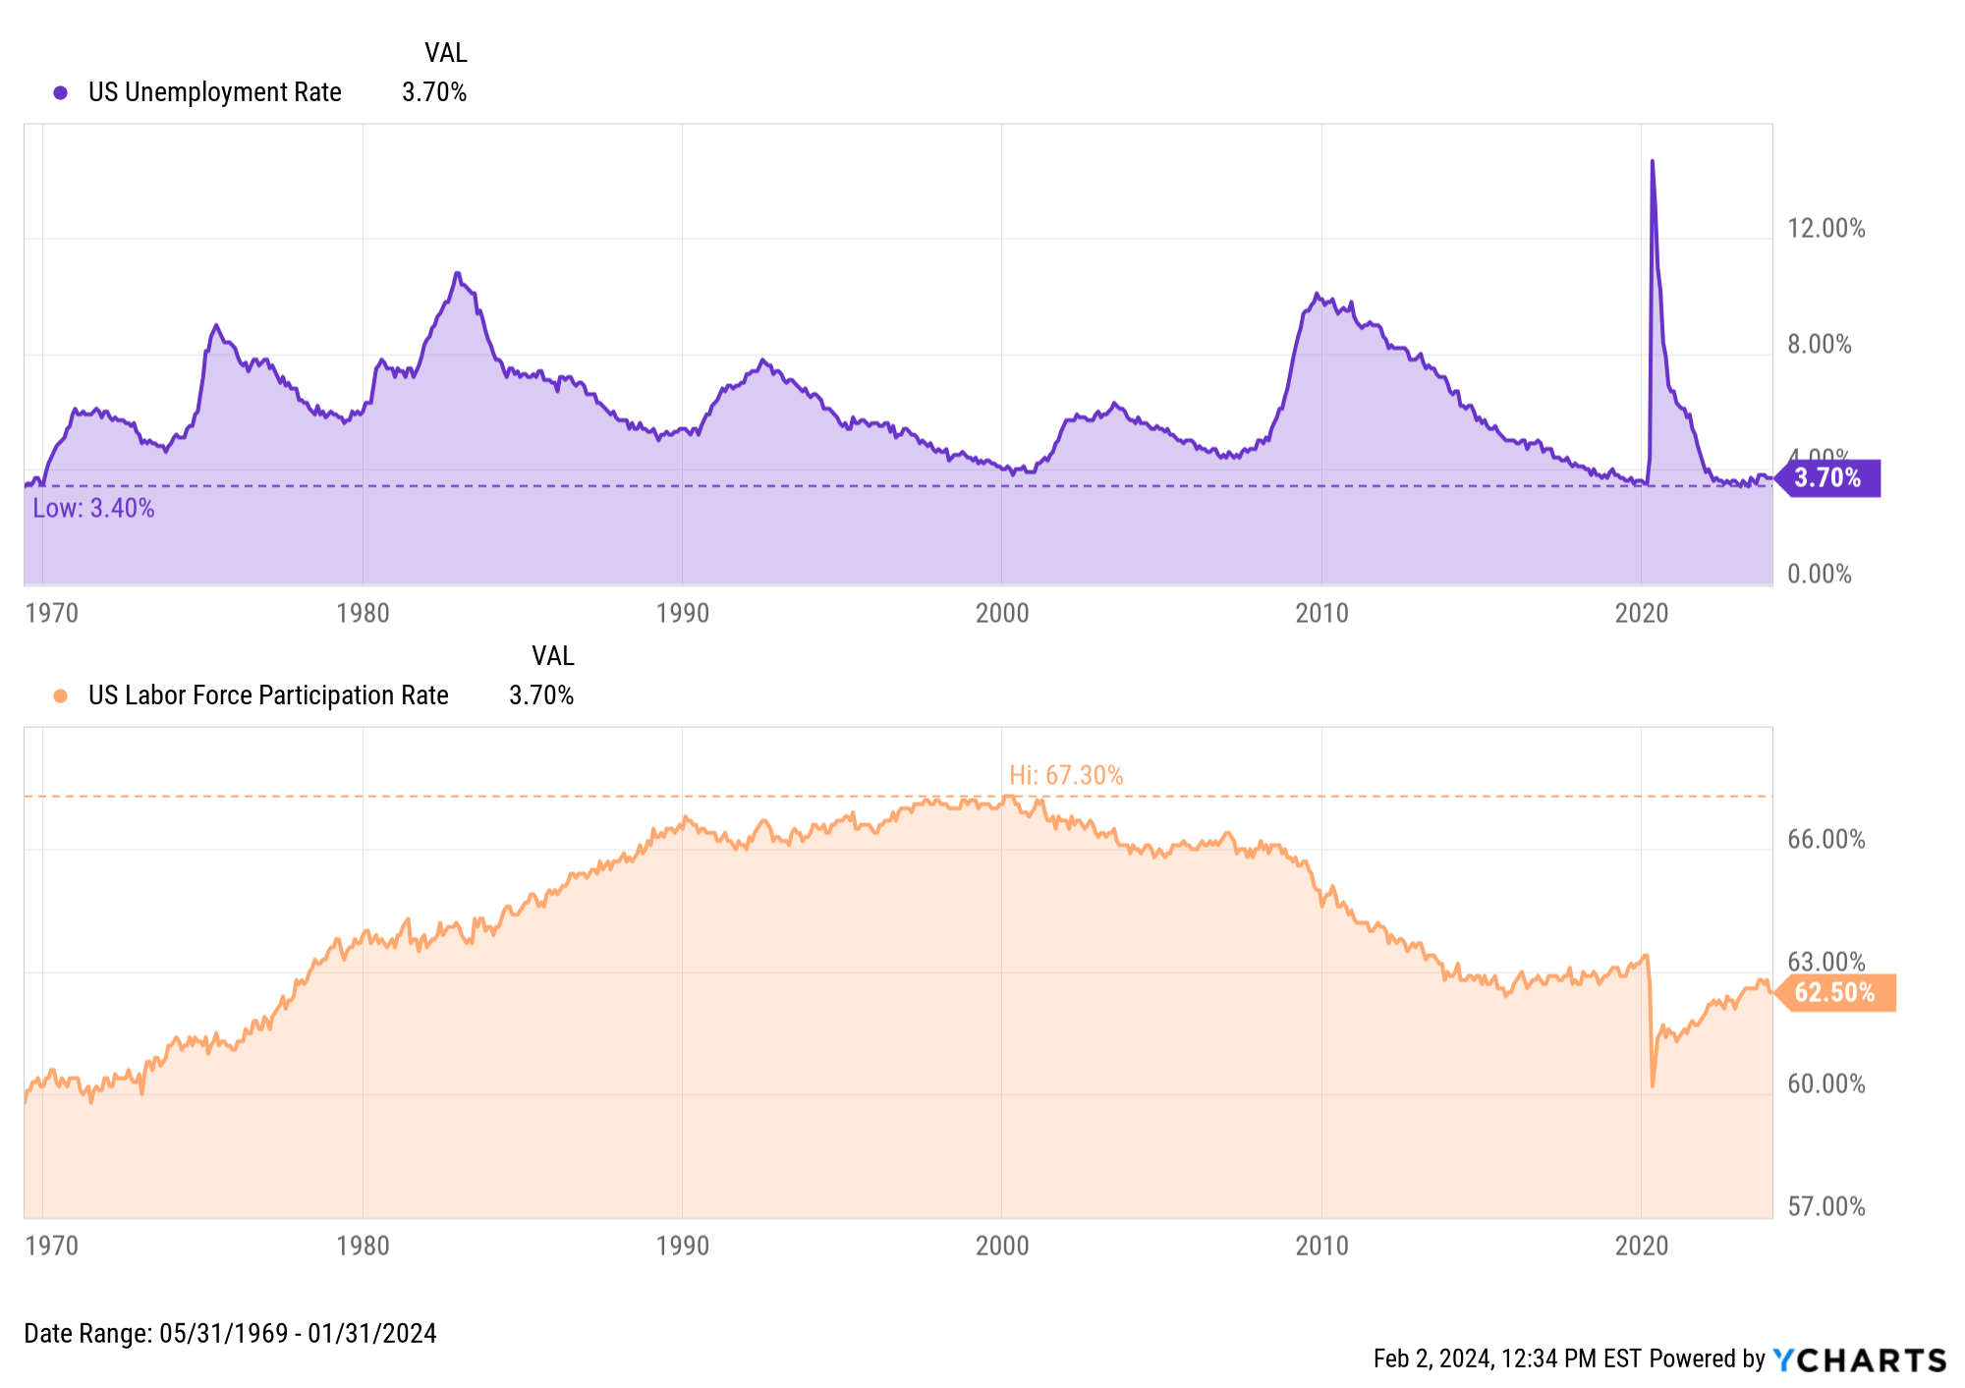
Employment
Notes:
January’s unemployment rate stayed unchanged at 3.7%, as did the labor force participation rate at 62.5%. The US unemployment rate has now come in at 3.7% for three consecutive months.

Slide 11
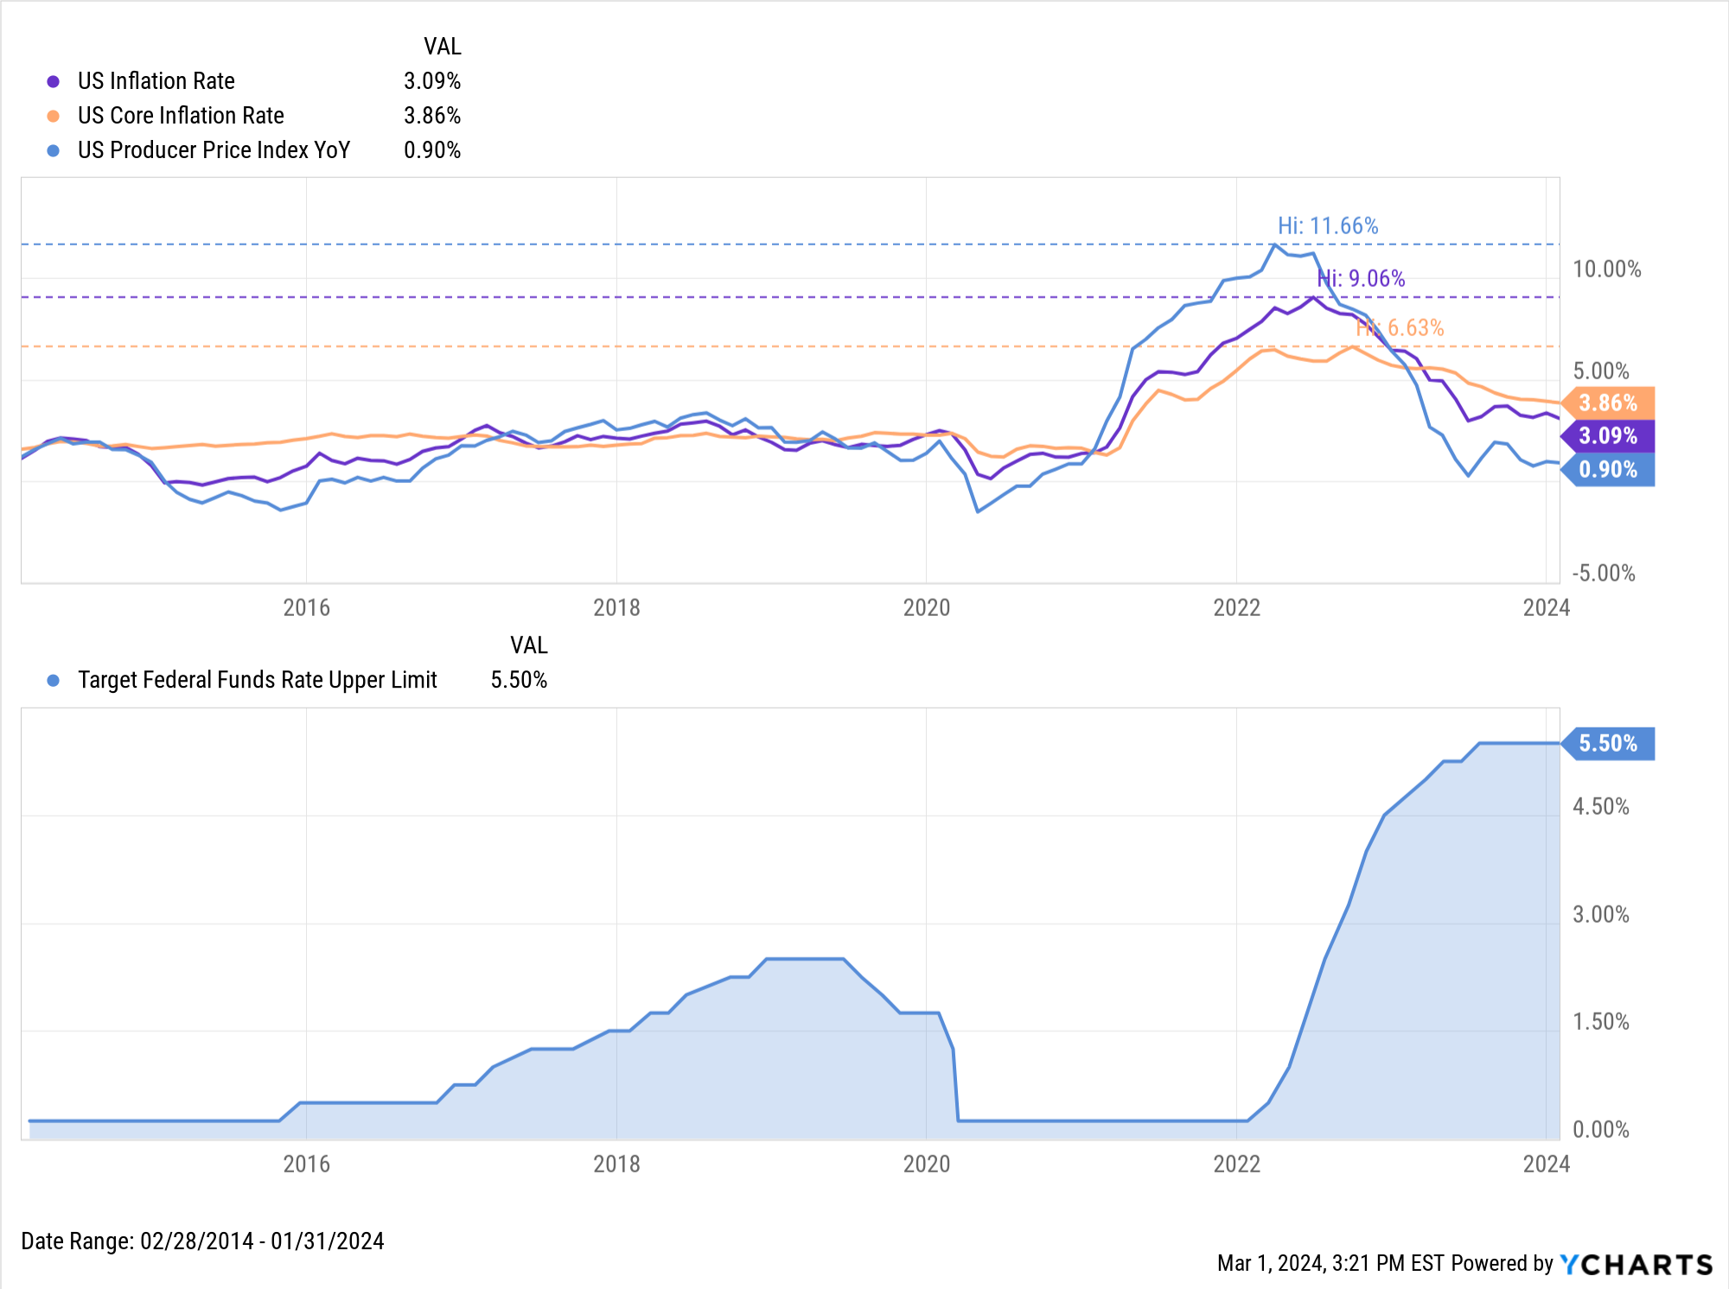
Inflation vs. Fed Funds Rate
Notes:
The US inflation rate for January increased slightly to start the year, to 3.09%. Inflation has hovered in the 3 percent range since July, though it just logged its lowest YoY level since then. Core Inflation decreased slightly to 3.86% in January, nonetheless logging its 10th consecutive monthly decline. The monthly US Consumer Price Index rose 0.3% in January, and monthly US Personal Spending inched up 0.2%.
The Federal Reserve held its key Fed Funds Rate at 5.50% at its January 31st, 2024 meeting, marking the Fed’s fourth consecutive meeting in which rates were left unchanged.

Slide 12
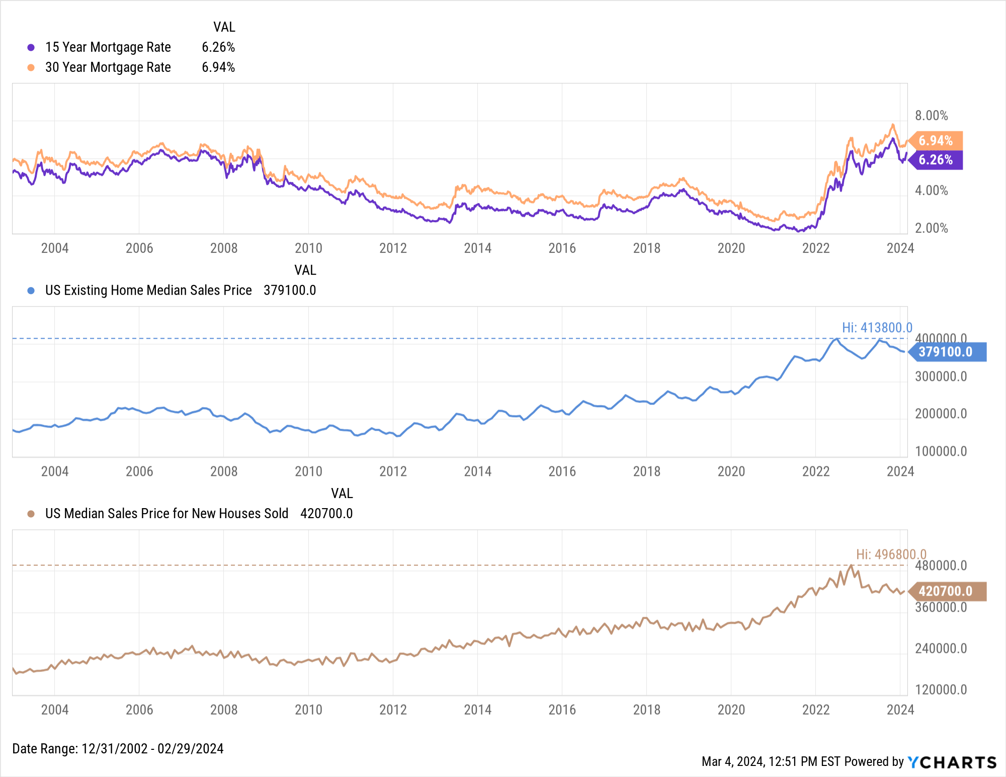
Housing Prices and Mortgage Rates
Notes:
MoM US New Single-Family Home Sales increased 1.5% in January, and MoM US Existing Home Sales increased by 3.1% to 4.00M in January. The Median Sales Price of Existing Homes fell 0.6% to $379,100 in January, a seventh straight monthly decline putting it 7.6% below its all-time high set in June 2023.
Mortgage rates increased slightly in February; the 15-year Mortgage Rate rose to 5.94% as of February 29th, and the 30-year ended the month at 6.94%.

Slide 13
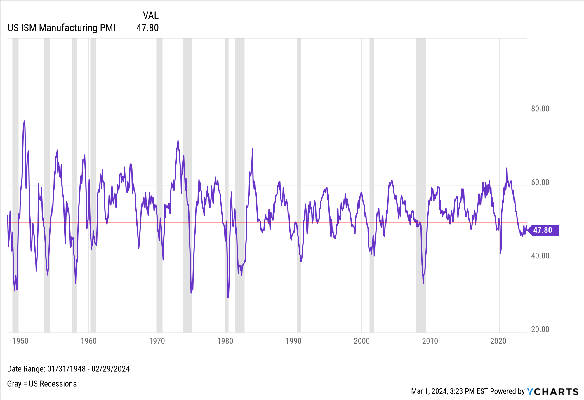
Manufacturing
Notes:
The US ISM Manufacturing PMI failed to break into expansion territory, falling by 1.3 points in February to 47.8.

Slide 14
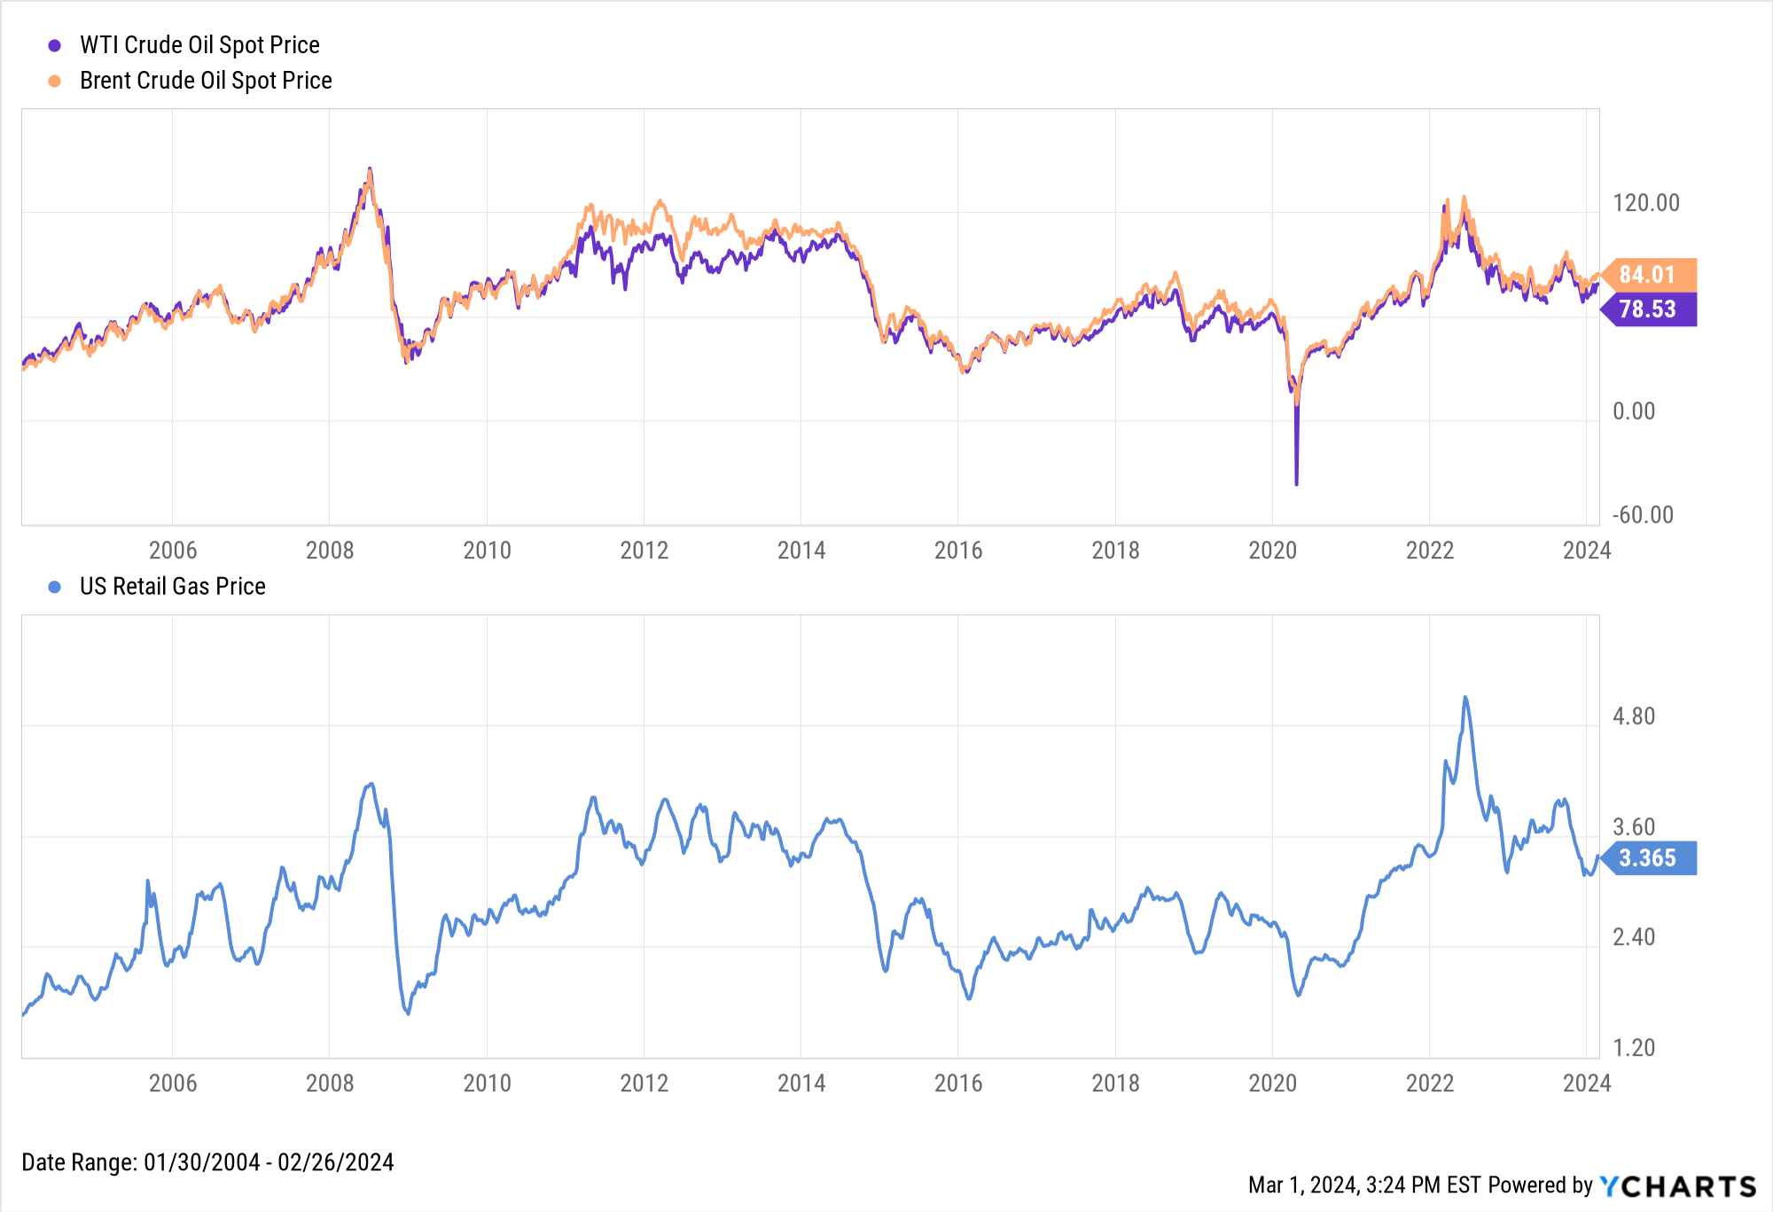
Oil & Gas Prices
Notes:
Crude oil prices continued higher in February; the price of WTI was 3% higher at $78.53 per barrel while Brent rose 1.2% to $84.01 both as of February 26th. Higher oil prices led the average price of gas to increase 13 cents per gallon in February, closing the month at $3.37 per gallon.

Slide 15
Fixed Income
Featuring the US Treasury Yield Curve, plus performance of select bond ETFs
Notes:
Treasury yields rose across the board even as equities rallied. Intermediate duration instruments posted the largest increases; the 2-year, 3-year, and 5-year all increased by 35 bps or more.
Bond ETFs largely mimicked their January performances in February. The short-term SPDR Bloomberg 1-3 Month T-Bill ETF (BIL) and iShares Boxx High Yield Corporate Bond (HYG) both inched higher. In long-term bonds, the iShares 20+ Year Treasury Bond ETF (TLT) fell 2.3% for the second straight month.

Slide 16
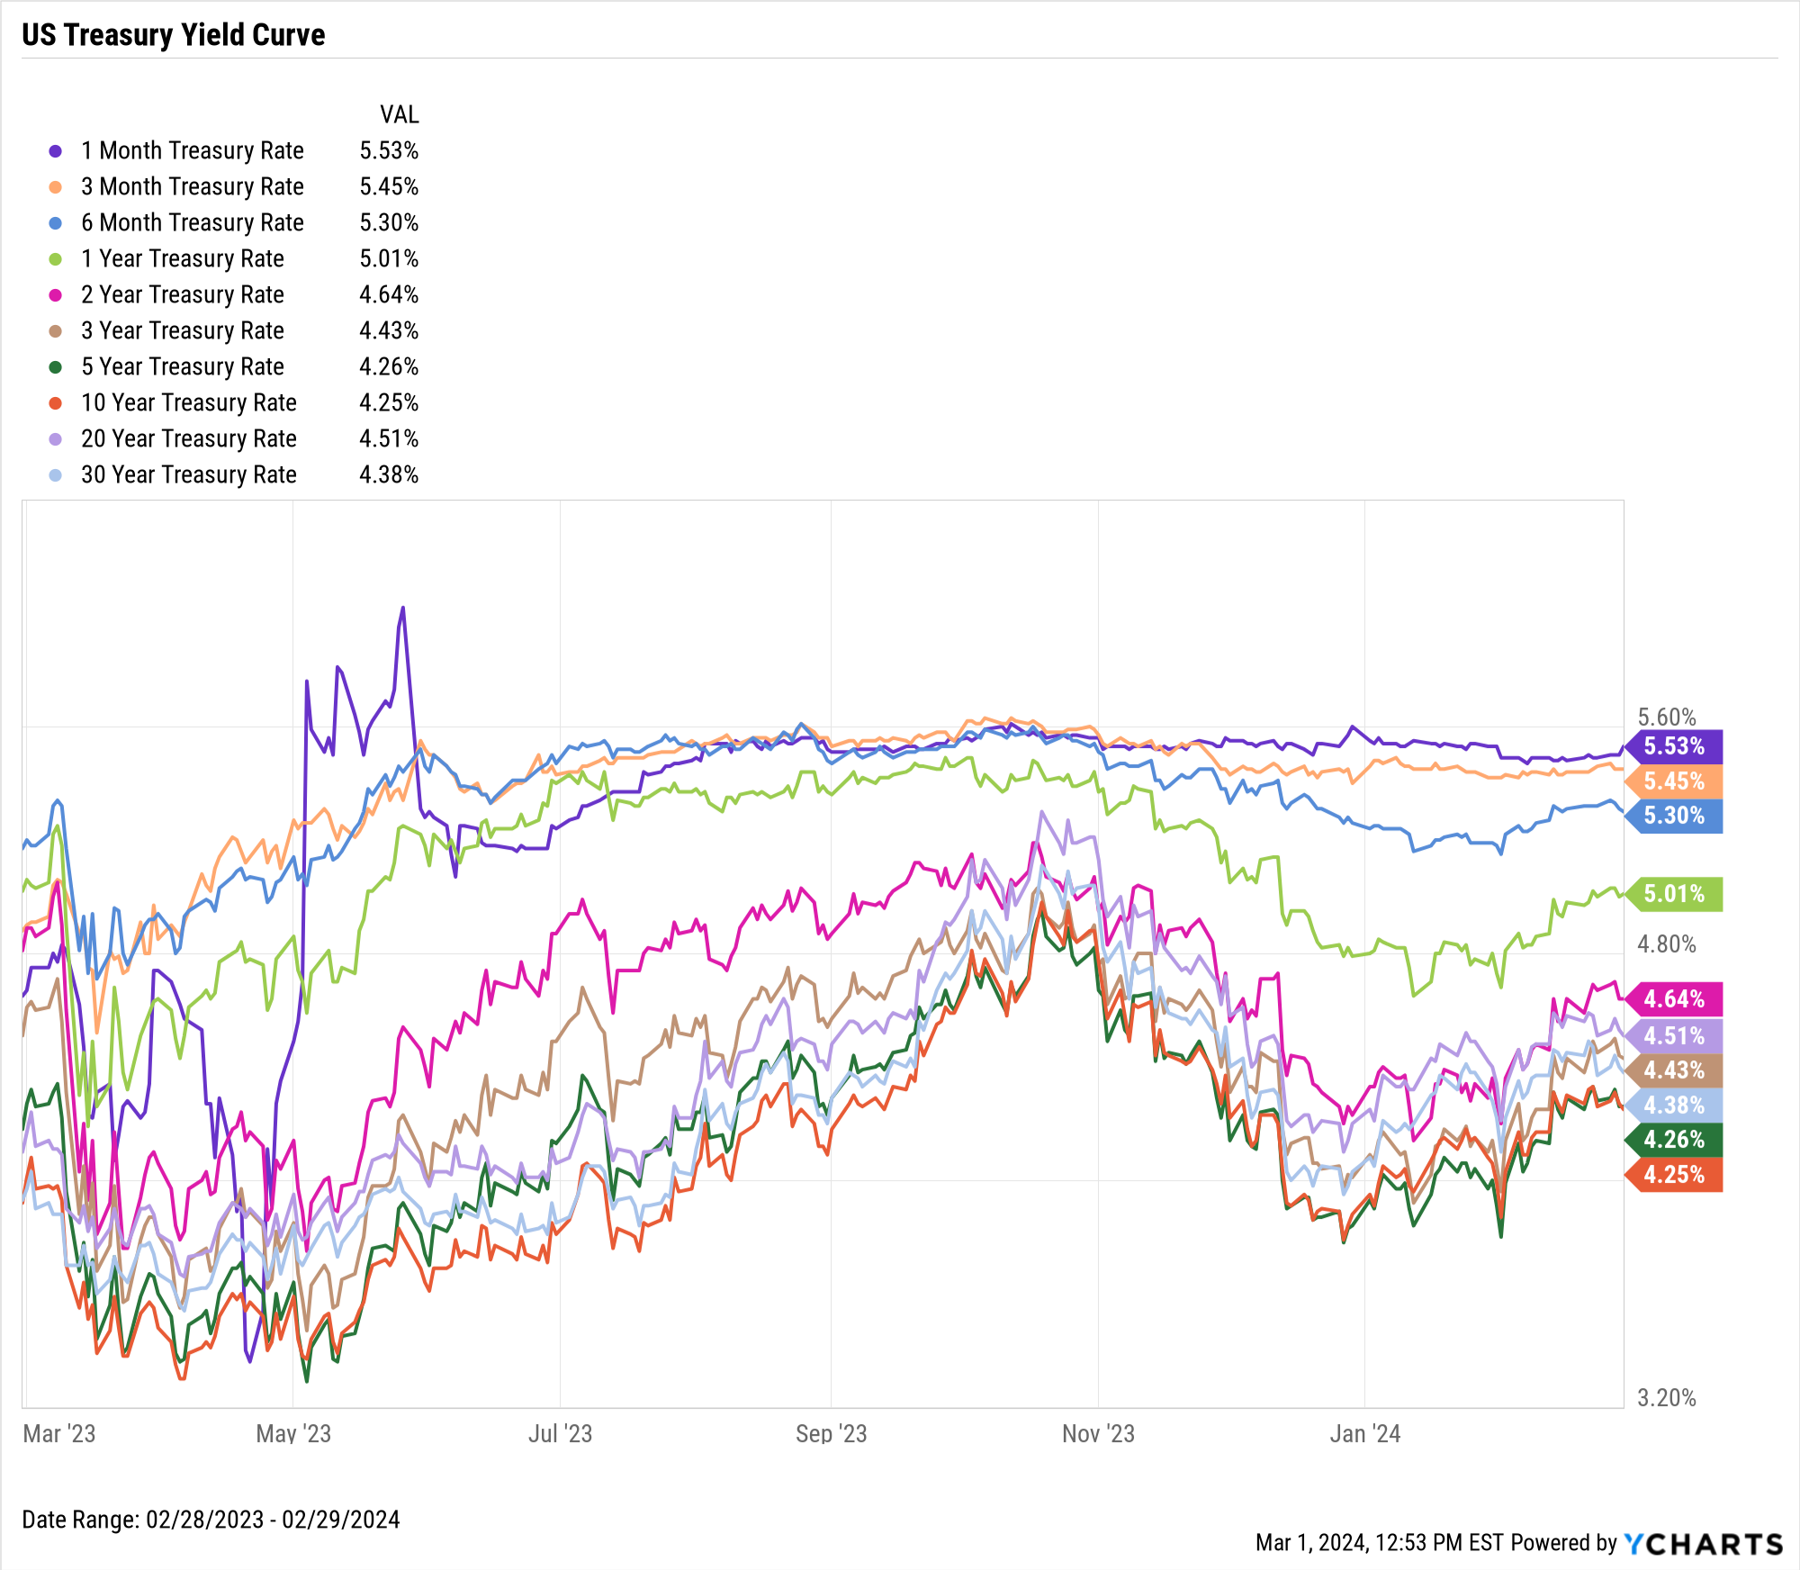
US Treasury Yield Curve
Duration | Rate | MoM Δ
1-Month | 5.53% | UnCh
3-Month | 5.45% | ▲ 3 bps
6-Month | 5.30% | ▲ 12 bps
1-Year | 5.01% | ▲ 28 bps
2-Year | 4.64% | ▲ 37 bps
3-Year | 4.43% | ▲ 38 bps
5-Year | 4.26% | ▲ 35 bps
10-Year | 4.25% | ▲ 26 bps
20-Year | 4.51% | ▲ 17 bps
30-Year | 4.38% | ▲ 16 bps
Notes:
Treasury yields rose across the board even as equities rallied. Intermediate duration instruments posted the largest increases; the 2-year, 3-year, and 5-year all increased by 35 bps or more.

Slide 17
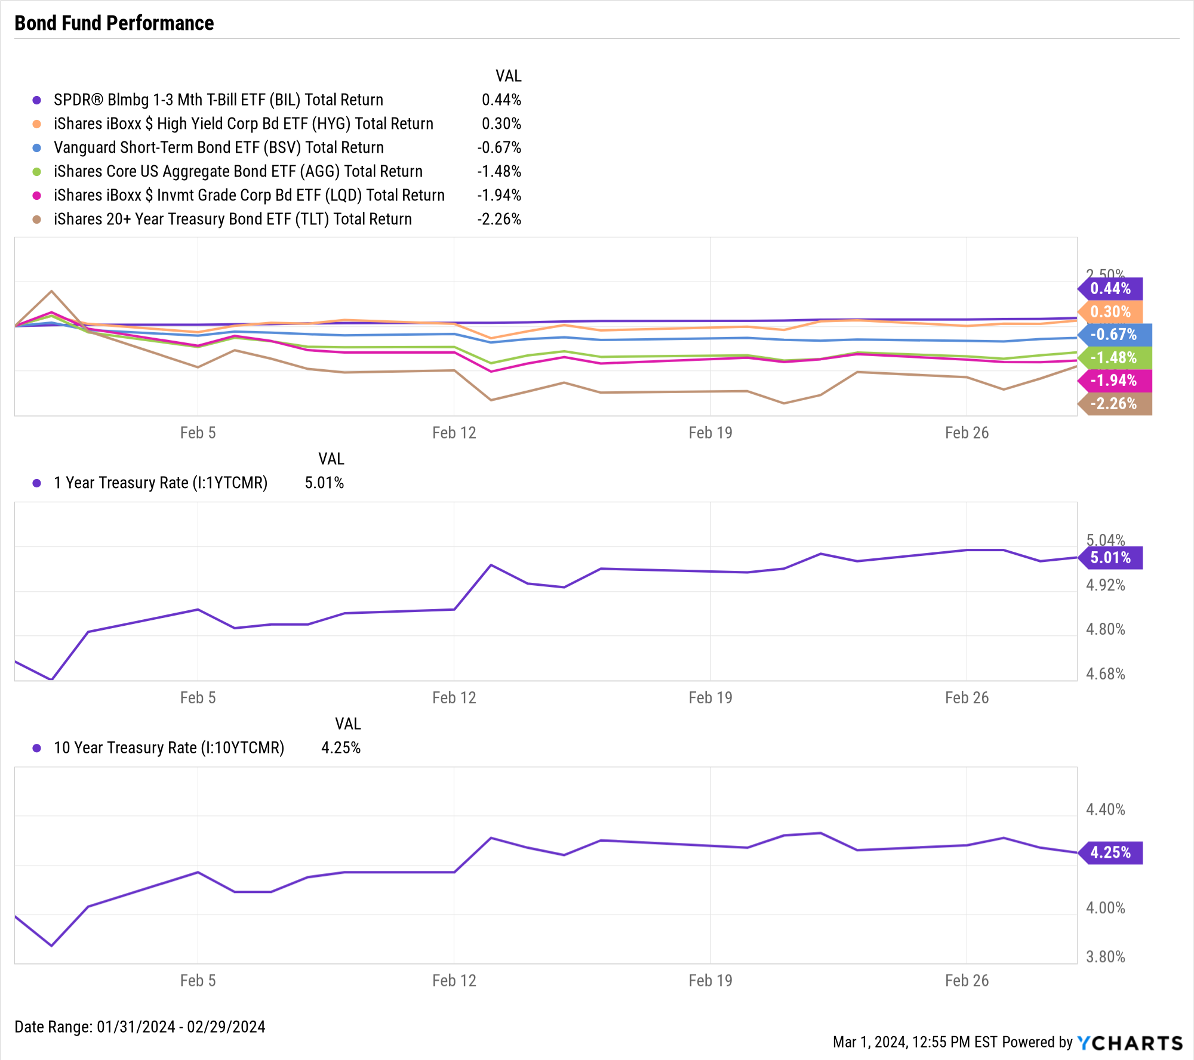
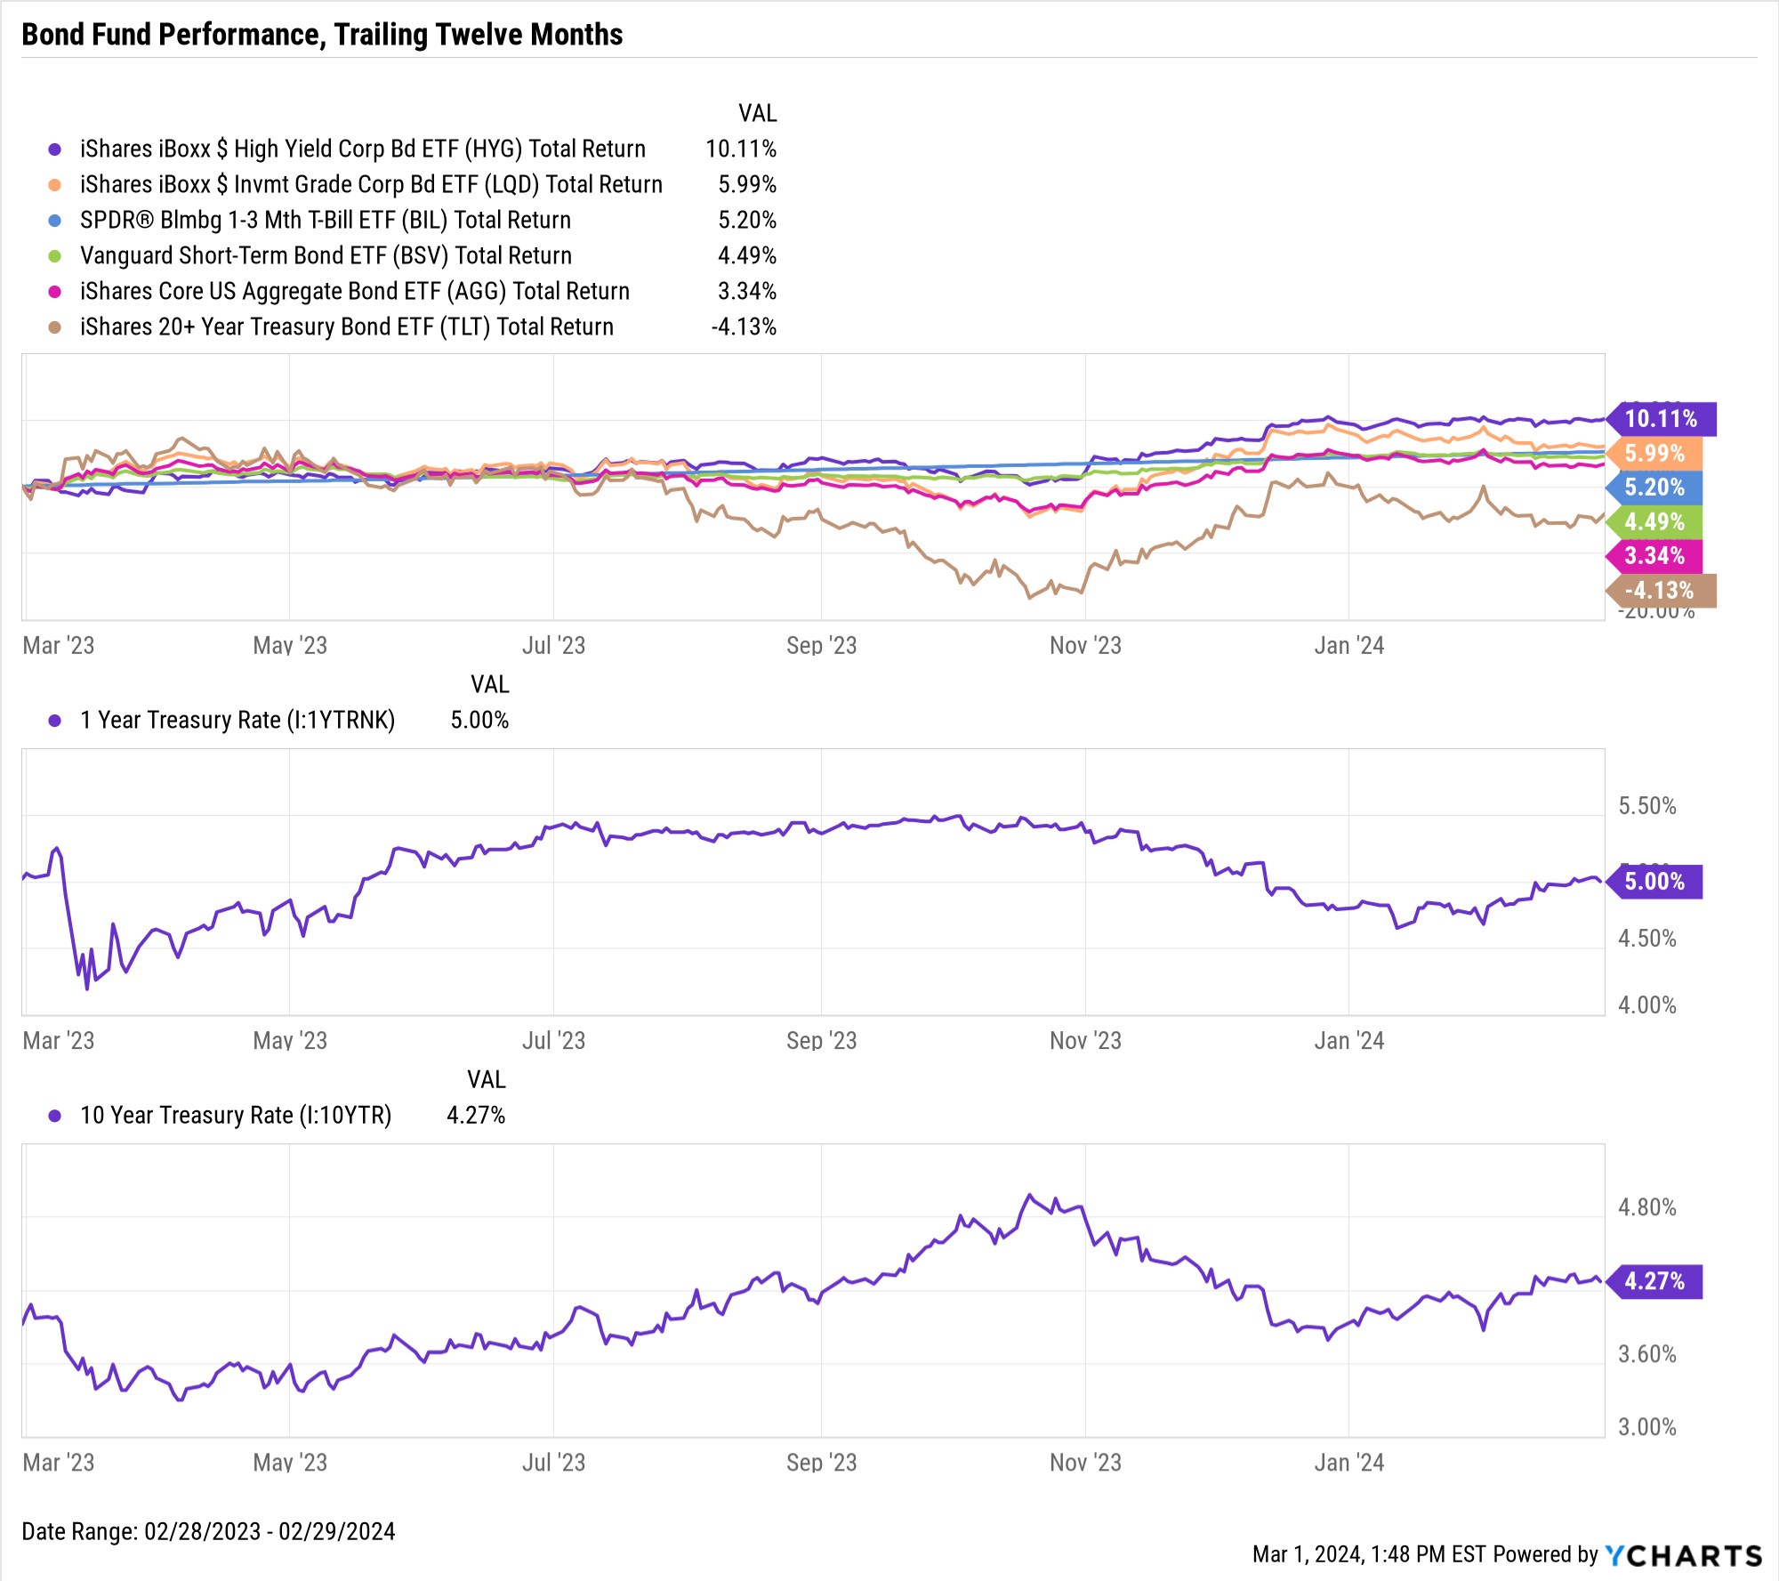
Bond Fund Performance
February 2024: Short-term funds eke slight gains, TLT falls another 2.3%
Trailing Twelve Months (TTM): High-Yield HYG up 10%, TLT down 4.1%
Notes:
Bond ETFs largely mimicked their January performances in February. The short-term SPDR Bloomberg 1-3 Month T-Bill ETF (BIL) and iShares Boxx High Yield Corporate Bond (HYG) both inched higher. In long-term bonds, the iShares 20+ Year Treasury Bond ETF (TLT) fell 2.3% for the second straight month.

